Slide 1
API
Yousuf Bin Azhar
Software Engineering – L2
Habib University

Slide 2
API
APIs are mechanisms that enable two software components to communicate with each other using a set of definitions and protocols.
For example, the weather app on your phone “talks” to this system via APIs and shows you daily weather updates on your phone.
API stands for Application Programming Interface.
Application refers to any software with a distinct function.
Interface - a contract of service between two applications

Slide 3
Types of APIs
SOAP APIs - Simple Object Access Protocol. Client and server exchange messages using XML. This is a less flexible API that was more popular in the past.
RPC APIs - Remote Procedure Calls. The client completes a function (or procedure) on the server, and the server sends the output back to the client.
Websocket APIs - Uses JSON objects to pass data. Supports two-way communication between client apps and the server. The server can send callback messages to connected clients, making it more efficient than REST API.
REST APIs - Most popular and flexible APIs found on the web. The client sends requests to the server as data. The server uses this client input to start internal functions and returns output data back to the client.

Slide 4
REST APIs
REST stands for Representational State Transfer. REST defines a set of functions like GET, PUT, DELETE, etc. that clients can use to access server data. Clients and servers exchange data using HTTP.
The main feature is statelessness. Statelessness means that servers do not save client data between requests.
Client requests to the server are similar to URLs you type in your browser to visit a website. The response from the server is plain data, without the typical graphical rendering of a web page.
Also called Web APIs

Slide 5
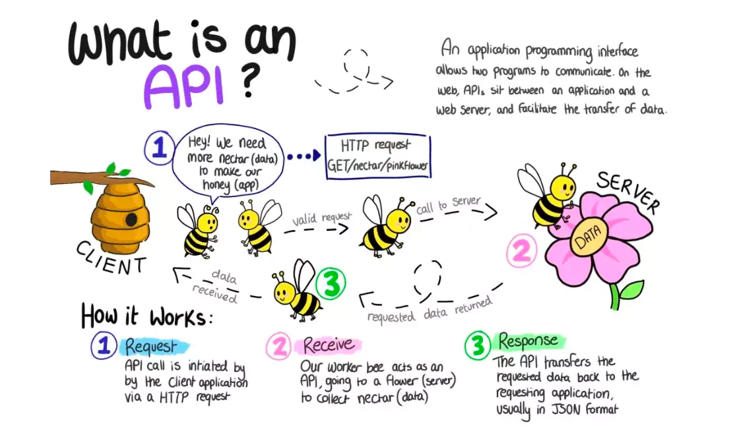

Slide 6
API endpoints
API endpoints are the final touchpoints in the API communication system.
These include
server URLs
services
Ports
Security
API endpoints make the system vulnerable to attack. API monitoring is crucial for preventing misuse.
Performance
API endpoints, especially high traffic ones, can cause bottlenecks and affect system performance.

Slide 7
Microservices
An architectural style that structures an application as a collection of small, independent, and loosely coupled services.
Each microservice is designed to perform a specific business function and can communicate with other microservices through lightweight protocols, such as HTTP or messaging systems.
Typically deployed independently and can be scaled horizontally, allowing for greater flexibility and resilience.
Platform independent
Faster development and deployment times, improved scalability, better fault isolation, and easier maintenance and updates.

Slide 8
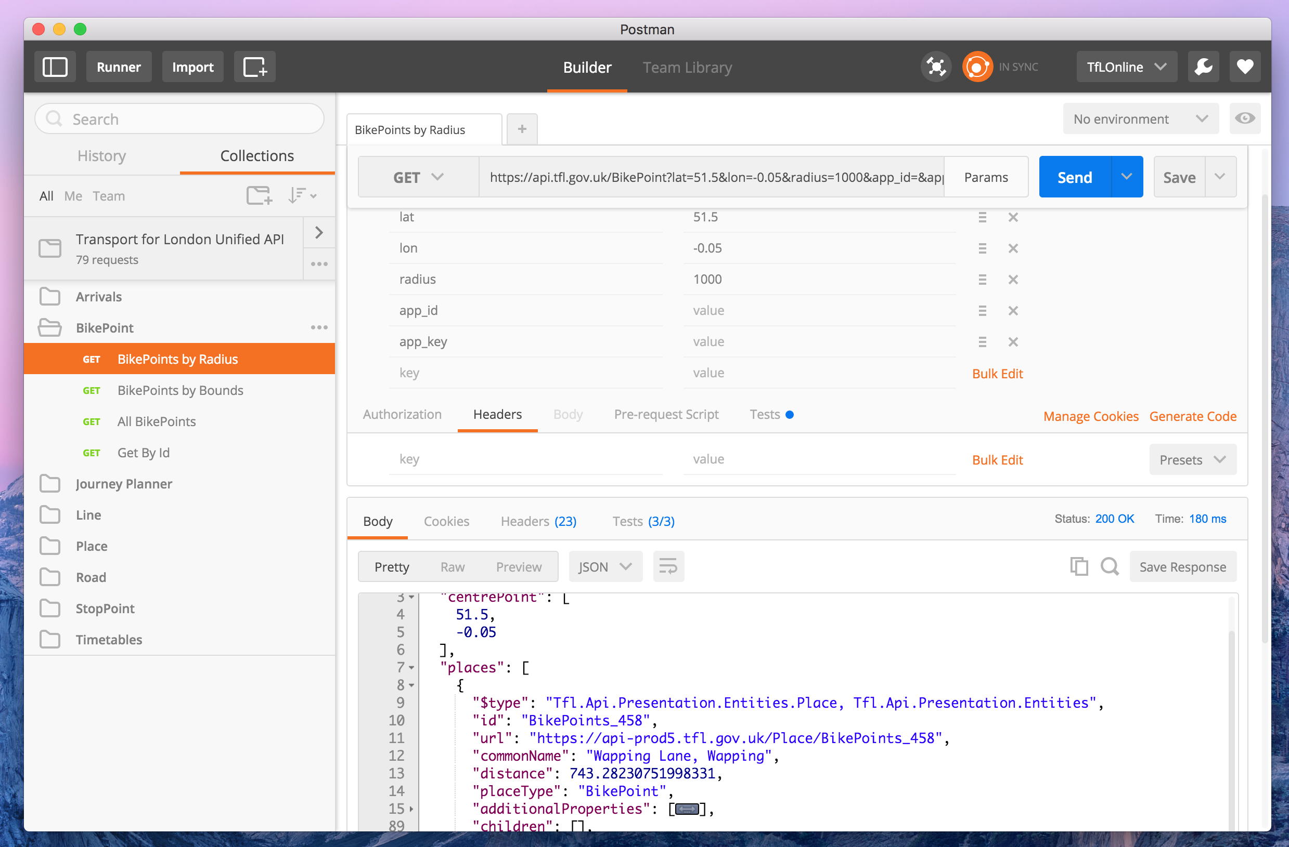

Slide 9
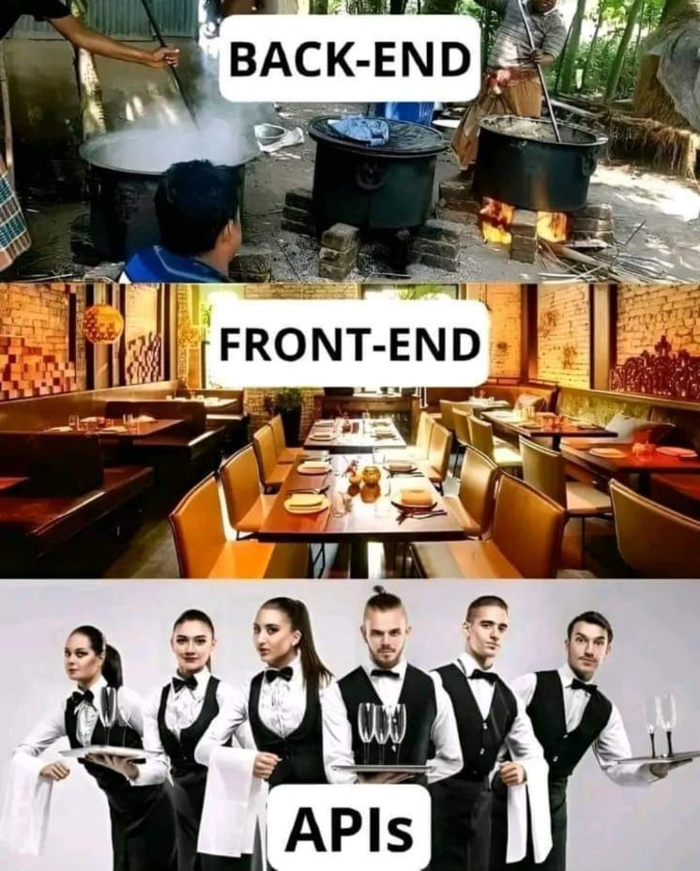

Slide 10
References
https://aws.amazon.com/what-is/api/#:~:text=API%20stands%20for%20Application%20Programming,of%20service%20between%20two%20applications.
https://rapidapi.com/blog/api-glossary/api/#:~:text=An%20API%20(Application%20Programming%20Interface,each%20other%20through%20Facebook%20Messenger.

